Slide 1
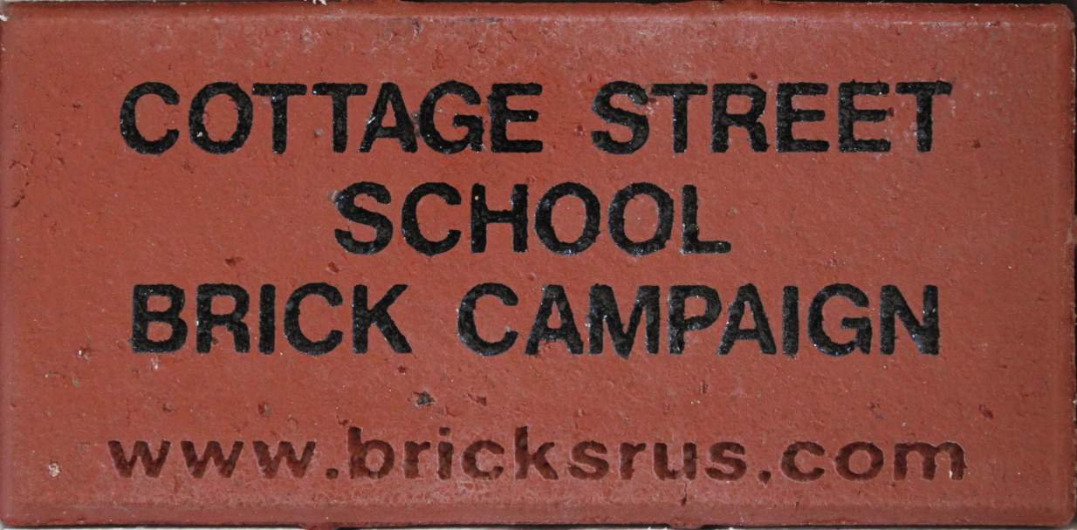
CSS Engraved Brick Fundraiser
Sales will help cover the cost of installing new brick walkway areas and upgrading the Poet’s Corner
Bricks will be sold for $75 and $95 based on location
Groundbreaking and installation of your engraved bricks will be in the Spring (date to be determined)

Slide 2
Donor Brick Areas
Existing
  Cougar Circle
  Walkways from Cougar Circle
  Half Circle sitting area by front entrance
New areas to be installed in the Spring
  Flagpole area
  Poet’s Corner
  Walkway to side of front entrance (For business sponsors)

Slide 3
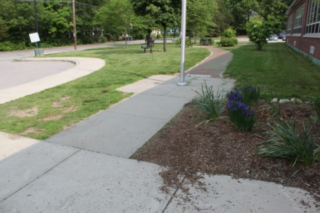
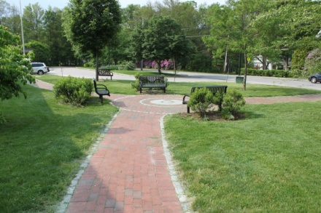
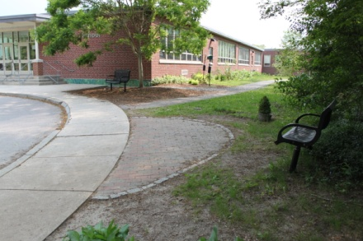
$75 Brick Locations
Walkways leading to Cougar Circle
New area adjacent to Flagpole
Half Moon to side of front entrance

Slide 4
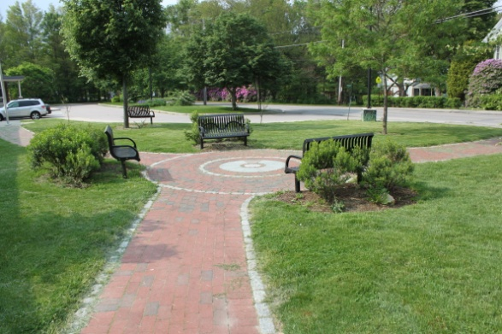
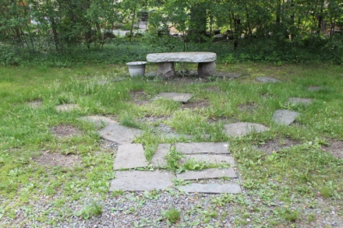
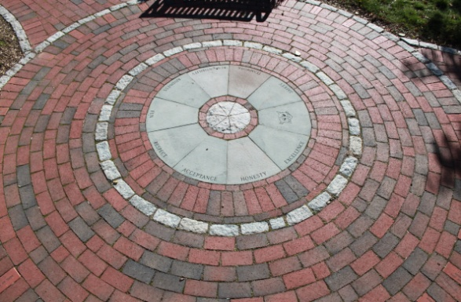
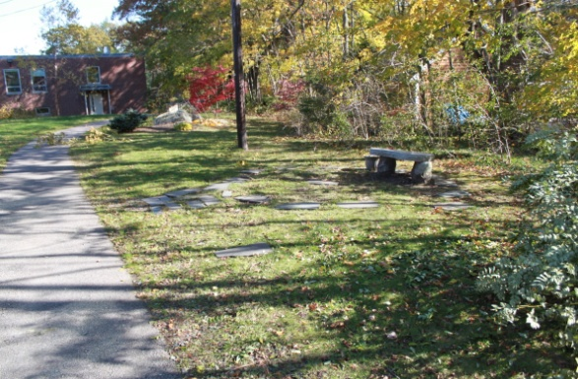
$95 Brick Locations
Cougar Circle
Poet’s Corner (new)

